Slide 1


GIT and TortoiseGIT
Nhat Phan-May 2016

Slide 2
Agenda
Version control - GIT introduction
How to use
Best practices
Code submission process
Q & A
References

Slide 3
Version Control
Version Control: system that records changes to a file or set of files over time so that you can recall specific versions later.
Features:
Revert files/entire project back to a previous state.
Compare changes over time
Check who last modified something
Check who introduced an issue and when, and more.

Slide 4
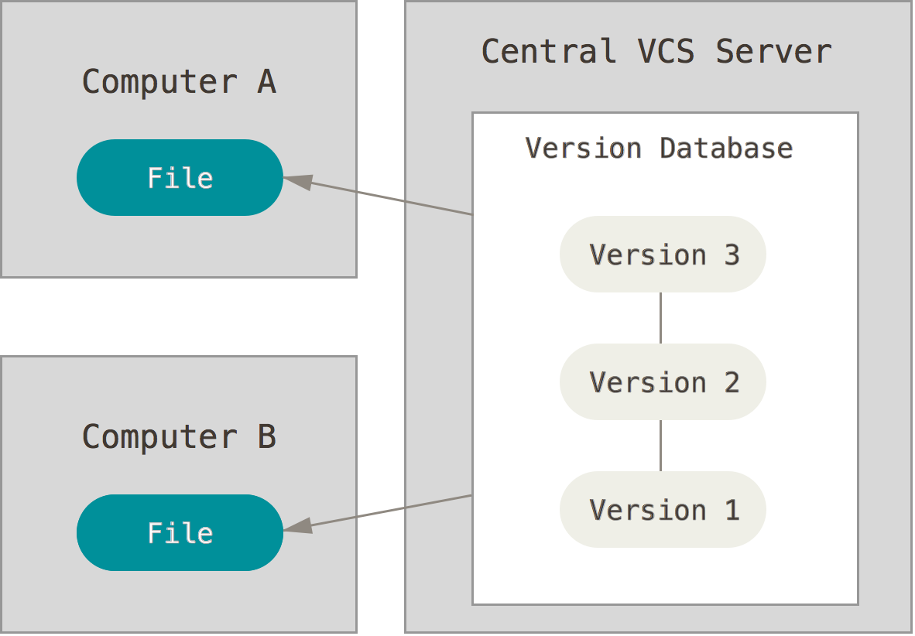
Centralized Version Control Systems
CVS, Subversion, and Perforce, have a single server that contains all the versioned files, and a number of clients that check out files from that central place.
Disadvantage: lost collaboration when network down, lose history if hard drive of server got issue.
Notes:
If that server goes down for an hour, then during that hour nobody can collaborate at all or save versioned changes to anything they’re working on. If the hard disk the central database is on becomes corrupted, and proper backups haven’t been kept, you lose absolutely everything – the entire history of the project except whatever single snapshots people happen to have on their local machines.

Slide 5
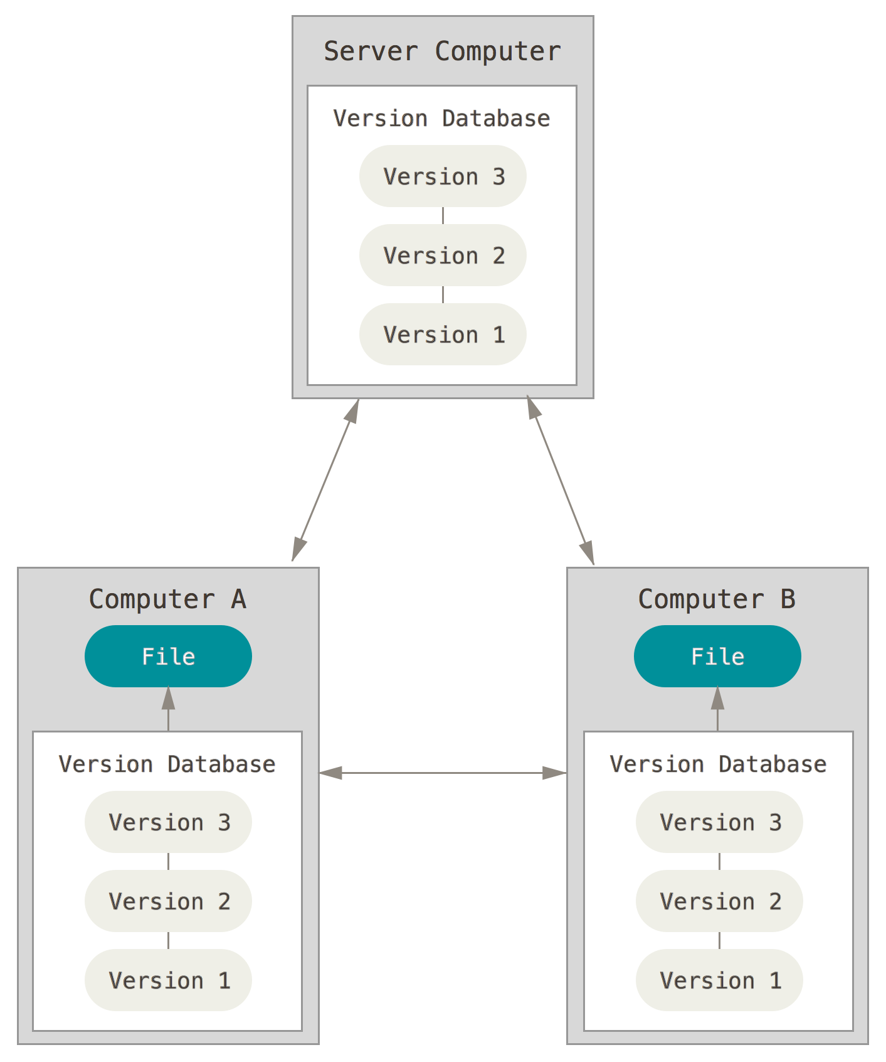
Distributed Version Control Systems
Clients don’t just check out the latest snapshot of the files: they fully mirror the repository.

Slide 6
GIT
DVCS.
Developed by Linus Torvalds, the creator of Linux.
Features:
Speed
Simple design
Strong support for non-linear development (thousands of parallel branches)
Fully distributed
Able to handle large projects like the Linux kernel efficiently speed and data size)

Slide 7
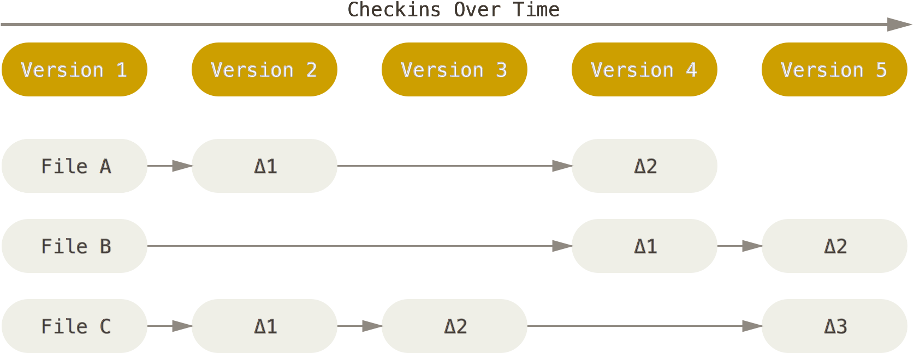
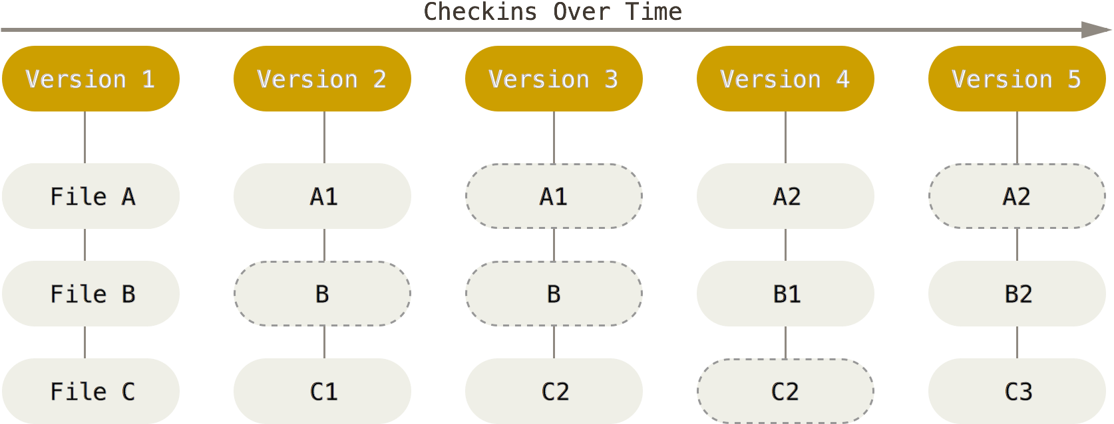
GIT basics
Snapshots, Not Differences
Notes:
Most other systems store information as a list of file-based changes. These systems (CVS, Subversion, Perforce, Bazaar, and so on) think of the information they keep as a set of files and the changes made to each file over time.
Git doesn’t think of or store its data this way. Instead, Git thinks of its data more like a set of snapshots of a miniature filesystem. Every time you commit, or save the state of your project in Git, it basically takes a picture of what all your files look like at that moment and stores a reference to that snapshot. To be efficient, if files have not changed, Git doesn’t store the file again, just a link to the previous identical file it has already stored. Git thinks about its data more like a stream of snapshots.
GIT care about the whole project, CVS just focus on changes in file
http://stackoverflow.com/questions/802573/difference-between-git-and-cvs

Slide 8
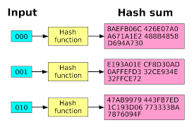
GIT basics
Nearly Every Operation Is Local
Integrity: Everything in Git (files, commits,…) is check-summed SHA-1 hash (E.g 24b9da6552252987aa493b52f8696cd6d3b00373)

Slide 9
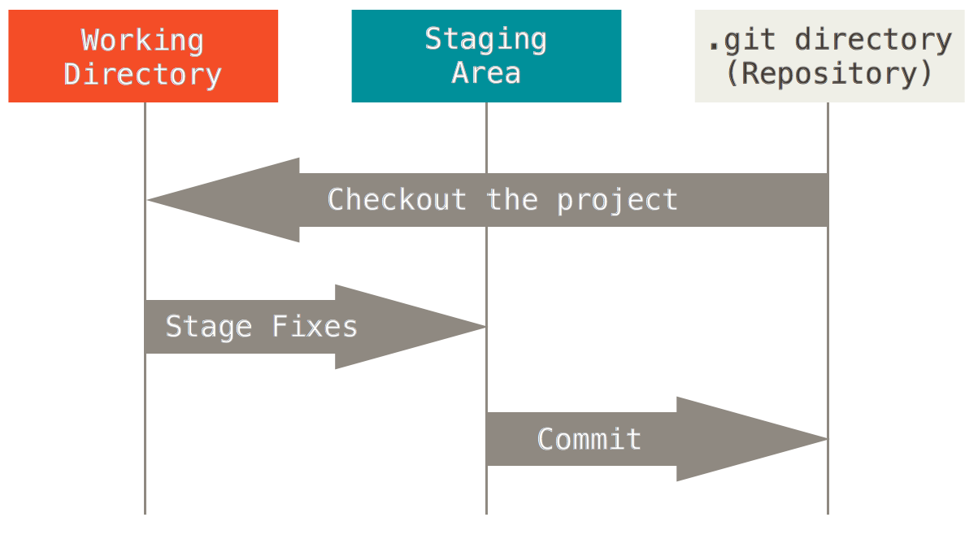
GIT basics
The Three States: committed, modified, and staged
Notes:
Committed means that the data is safely stored in your local database. Modified means that you have changed the file but have not committed it to your database yet. Staged means that you have marked a modified file in its current version to go into your next commit snapshot, it is still in the working directory.
The basic Git workflow goes something like this:
You modify files in your working directory.
You stage the files, adding snapshots of them to your staging area.
You do a commit, which takes the files as they are in the staging area and stores that snapshot permanently to your Git directory.
Git Directory
The .git directory that holds all information in the repository
Hidden from view
Working directory
The directory in which .git resides
Contains a "snapshot" of the repository
Will be changed constantly eg. when reverting or branching
Your changes will be made to this directory
Index (staged)
Changes have to be added to the index from the working directory in order to be saved into a commit
Could be thought of as a “loading bay” for commits

Slide 10
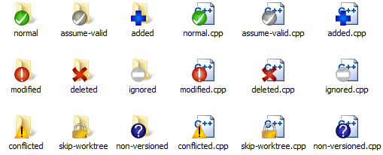
Tools
GIT command line
https://git-scm.com/download/win
Git support GUI tools for committing (git-gui) and browsing (gitk), built-in but there are several third-party tools for users looking for platform-specific experience.
GIT UI: TortoiseGIT
https://tortoisegit.org/
Integrated in Window Explorer

Slide 11
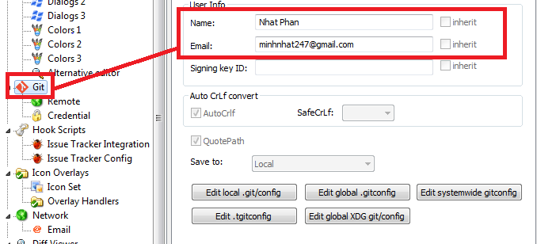
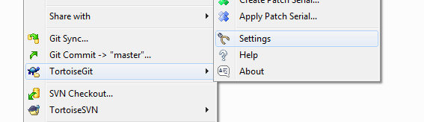
First-Time Git Setup
Your Identity: username and email
Via GIT command line (--global: for all projects)
$ git config --global user.name "John Doe"
$ git config --global user.email johndoe@example.com
Via TortoiseGIT
Notes:
This is important because every Git commit uses this information, and it’s immutably baked into the commits you start creating:

Slide 12
First-Time Git Setup
Checking your settings
Via GIT command line
$ git config --list
user.name=John Doe
user.email=johndoe@example.com
color.status=auto
color.branch=auto
color.interactive=auto
color.diff=auto
...
Your Editor (Optional)
Via GIT command line
$ git config --global core.editor "'C:/Program Files (x86)/Notepad++/notepad++.exe' -multiInst -nosession"

Slide 13
Initializing a Repository in an Existing Directory
On GIT server
$ git init
This creates a new subdirectory named .git that contains all of your necessary repository files – a Git repository skeleton.

Slide 14
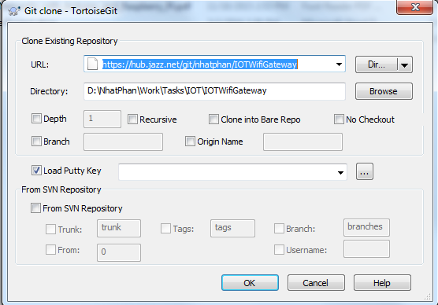
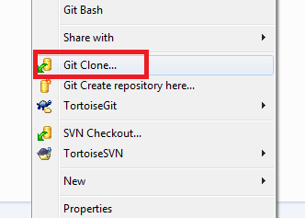
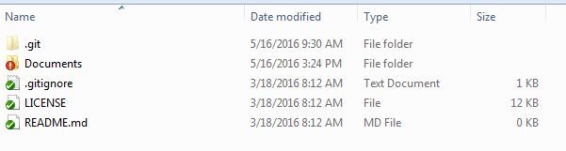
Cloning an Existing Repository
Via GIT command line
$ git clone https://hub.jazz.net/git/nhatphan/IOTWifiGateway
Via TortoiseGIT

Slide 15
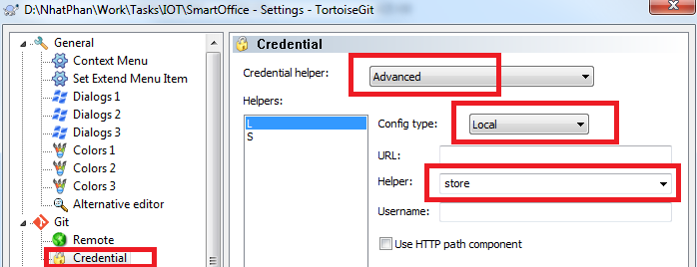
First-Time Git Setup
Saving credential
Via GIT command line
$ git config credential.helper store
Via TortoiseGIT

Slide 16
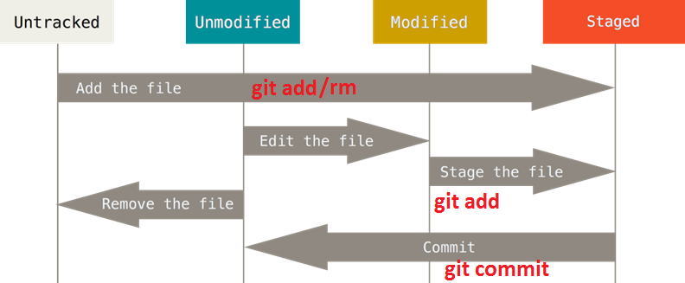
Recording Changes to the Repository

Slide 17
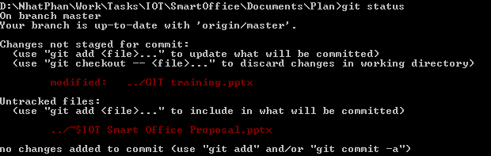
Checking status of file
Via GIT command line
$ git status
Via TortoiseGIT

Slide 18
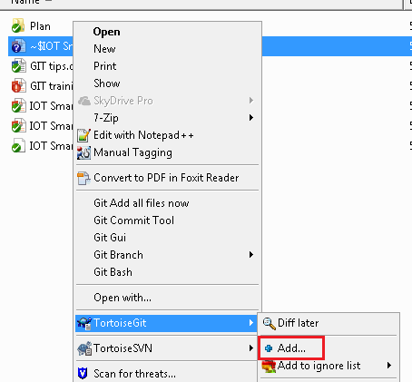
Staging Modified/New Files
Via GIT command line
$ git add "GIT training.pptx”
Via TortoiseGIT
Modified file won’t support add, it will be implement when committing.

Slide 19

Delete/Move/Rename Files
Via GIT command line
$ git rm “filename”
$ git mv “file_from” “file_to”
Via TortoiseGIT

Slide 20
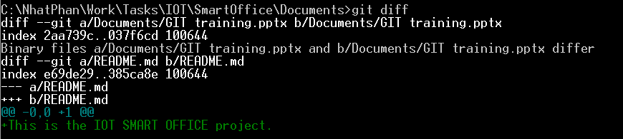
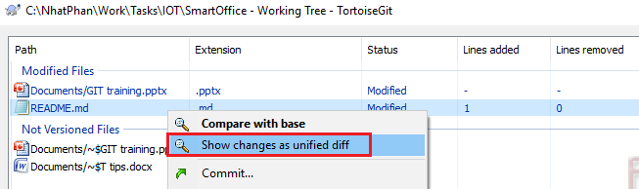
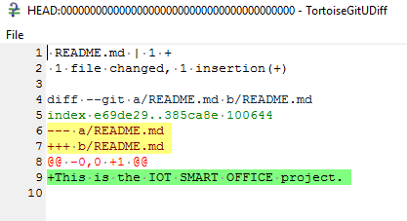
Viewing Your Staged and Unstaged Changes
Via GIT command line
$ git diff
Via TortoiseGIT
Notes:
Only apply for committed file only, untracked file won’t be compared

Slide 21
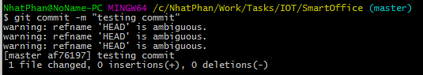
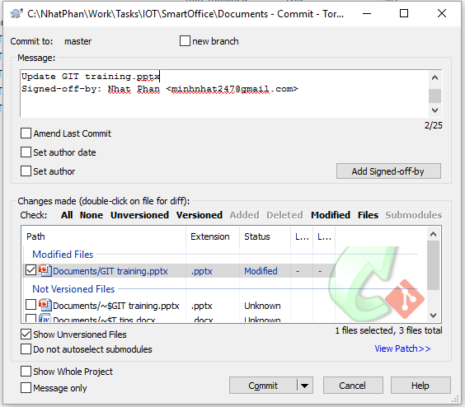
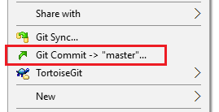
Commit
Via GIT command line
$ git commit – m “Message”
Via TortoiseGIT:

Slide 22
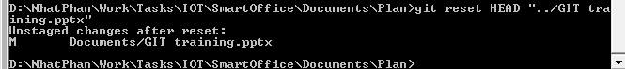
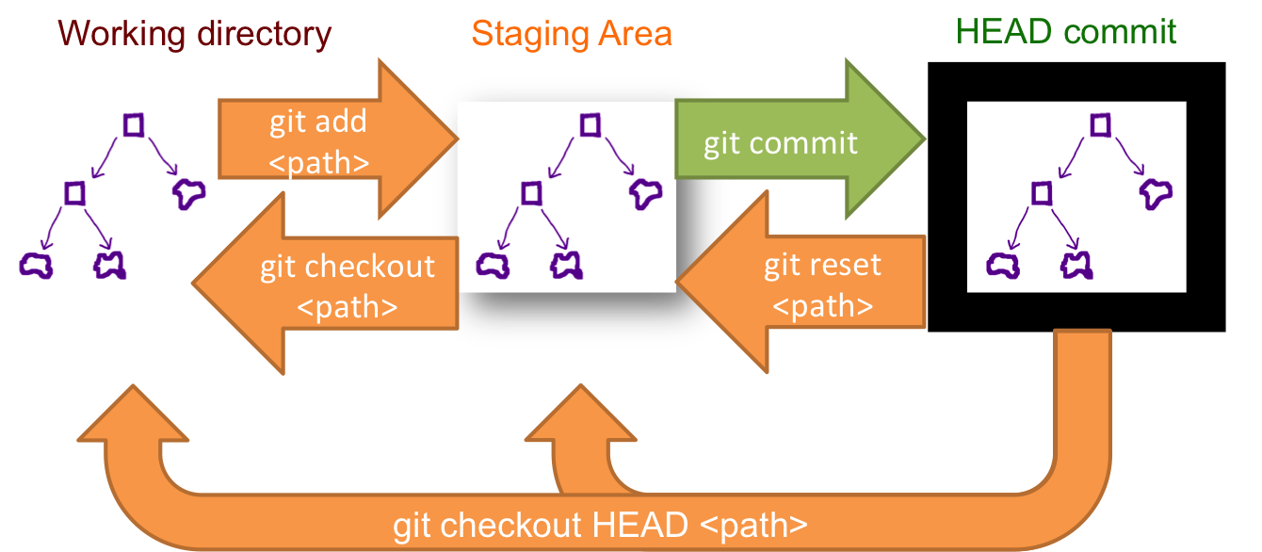
Un-staging Files
Via GIT command line
$ git reset HEAD "GIT training.pptx”
Or $git reset "GIT training.pptx”
Or $git reset → reset all files to unstage
Via TortoiseGIT: N/A
Notes:
http://schacon.github.io/git/git-rev-parse#_specifying_revisions
<rev>^, e.g. HEAD^, v1.5.1^0 A suffix ^ to a revision parameter means the first parent of that commit object. ^<n> means the <n>th parent (i.e. <rev>^ is equivalent to <rev>^1). As a special rule, <rev>^0 means the commit itself and is used when <rev> is the object name of a tag object that refers to a commit object.
<rev>~<n>, e.g. master~3 A suffix ~<n> to a revision parameter means the commit object that is the <n>th generation grand-parent of the named commit object, following only the first parents. I.e. <rev>~3 is equivalent to <rev>^^^ which is equivalent to <rev>^1^1^1. See below for an illustration of the usage of this form.

Slide 23
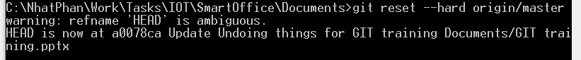
Undoing things (1)
Via GIT command line: reset, change commit, checkout
$ git commit --amend –m “Message” → Update message or add new file in previous commit.
$ git checkout -- “filename” → Discard changes in this file, any changes in the file will be gone. Note: check out without file new won’t overwrite changed files.
$ git reset –-hard → reset everything back to previous commit. It looks like checkout file.
$ git reset --hard origin/master → reset everything to remote master branch

Slide 24
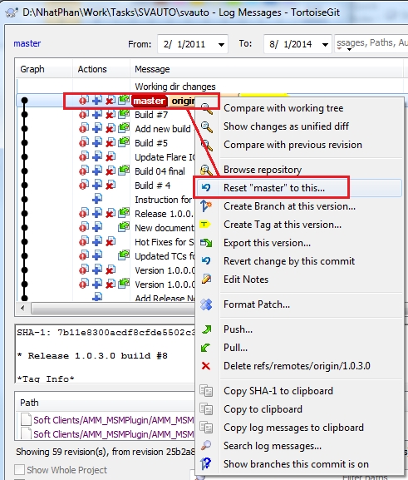
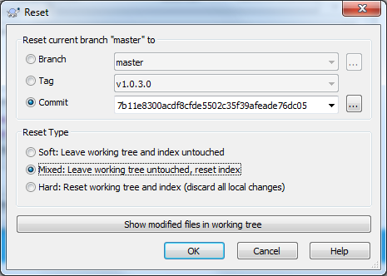
Undoing things (2)
Via TortoiseGit: reset

Slide 25
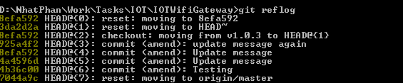
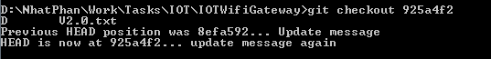
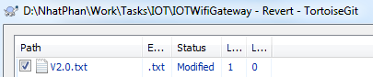
Undoing things (3)
Via GIT command line
$ git reflog→ List out historical commit.
$ git checkout “refID” → Switch everything to this commit refID.
Via TortoiseGIT: Checkout a file

Slide 26
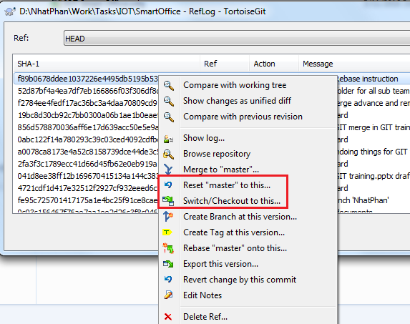
Undoing things (4)
Via TortoiseGIT: Checkout/reset to a commit

Slide 27
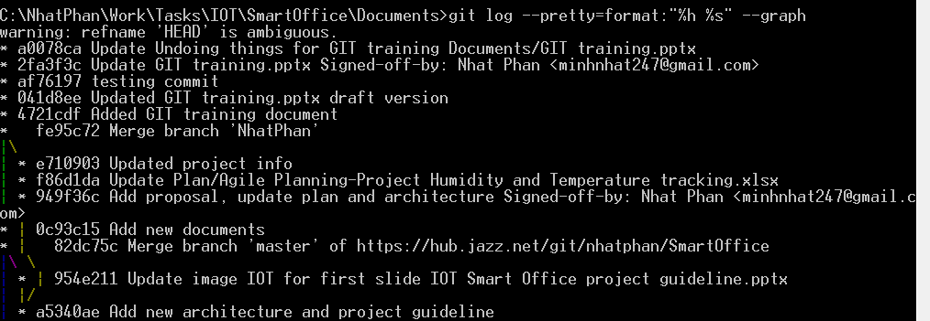
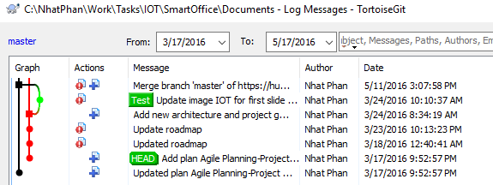
Viewing commit history
Via GIT command line
$ git log --pretty=format:"%h %s" --graph
Via TortoiseGIT:
Notes:
https://git-scm.com/book/be/v2/Git-Basics-Viewing-the-Commit-History

Slide 28
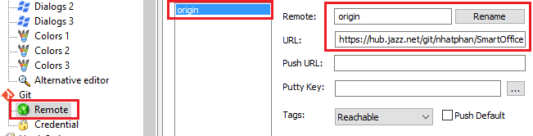
Working with Remotes
Via GIT command line
$ git clone https://github.com/schacon/ticgit
$ git remote add pb https://github.com/paulboone/ticgit
$ git remote –v
$ git fetch [remote-name]
Via TortoiseGIT:
Notes:
https://git-scm.com/book/be/v2/Git-Basics-Working-with-Remotes

Slide 29
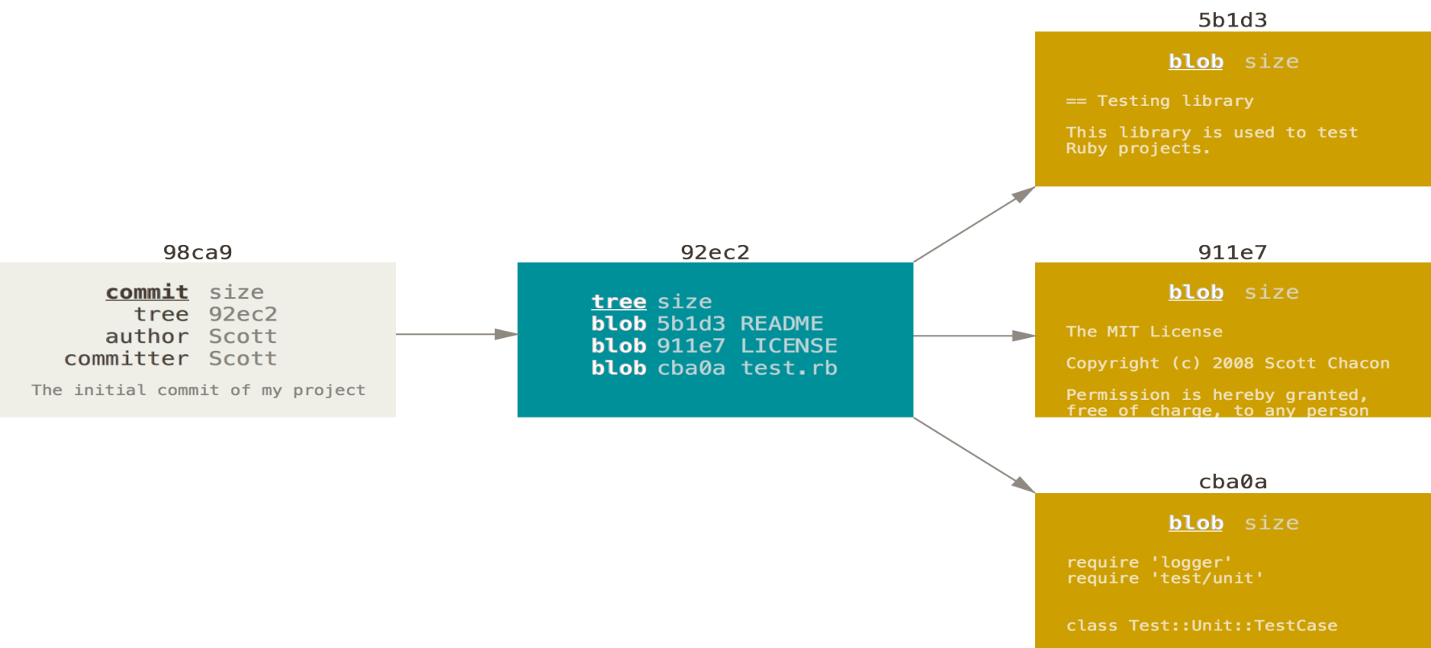
Inside staging and commit
Staging the files checksums each one (blobs)
Commit: checksums each subdirectory and stores those tree objects in the Git repository.
Notes:
Staging the files checksums each one, stores that version of the file in the Git repository (blobs)
Commit: checksums each subdirectory and stores those tree objects in the Git repository. Git then creates a commit object that has the metadata and a pointer to the root project tree so it can re-create that snapshot when needed.
Git five objects: one blob for the contents of each of your three files, one tree that lists the contents of the directory and specifies which file names are stored as which blobs, and one commit with the pointer to that root tree and all the commit metadata.

Slide 30
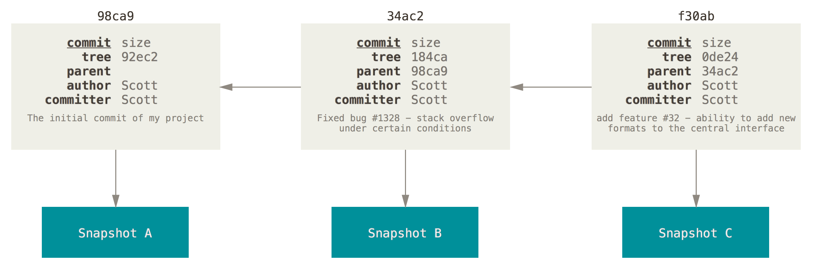
Inside staging and commit
Next commit

Slide 31
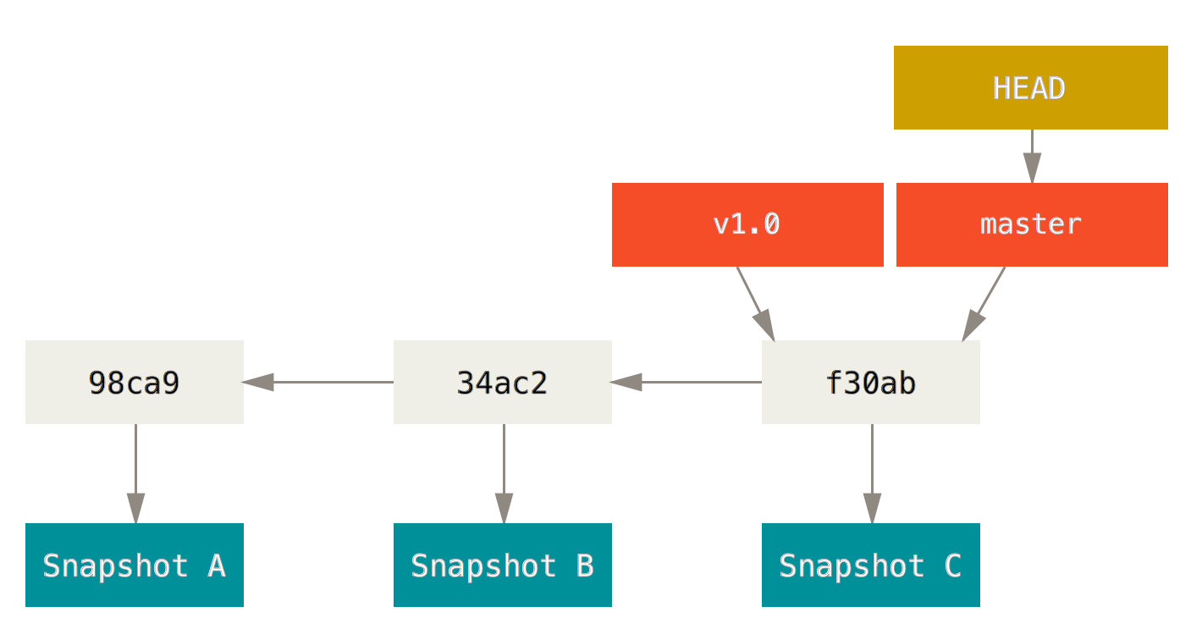
Branches
A branch in Git is simply a lightweight movable pointer to one of these commits.
The default branch name in Git is master.
Every time you commit, it moves forward automatically.

Slide 32
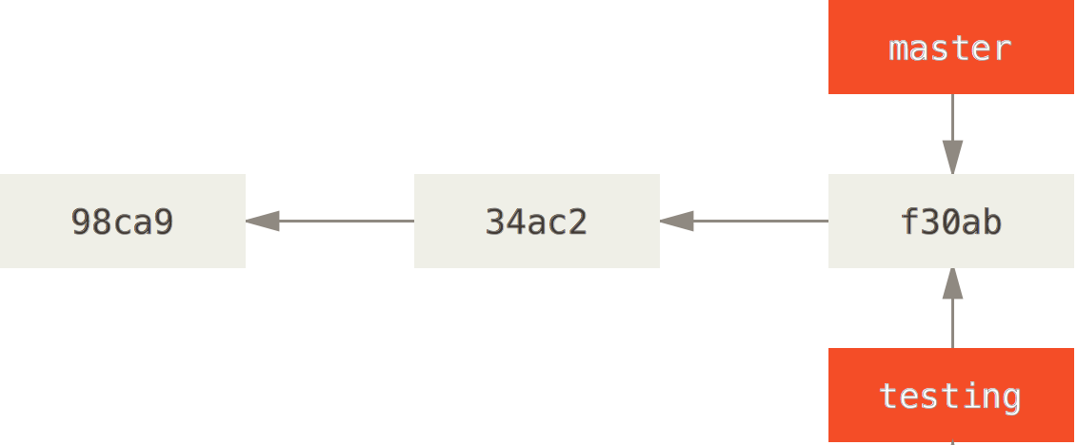
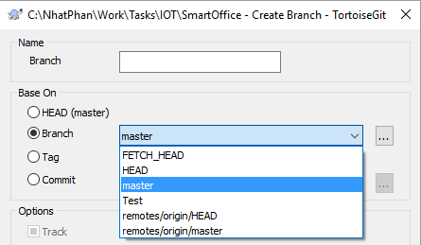
Create new branches (1)
Via GIT command line
$ git branch testing
Via TortoiseGIT:

Slide 33
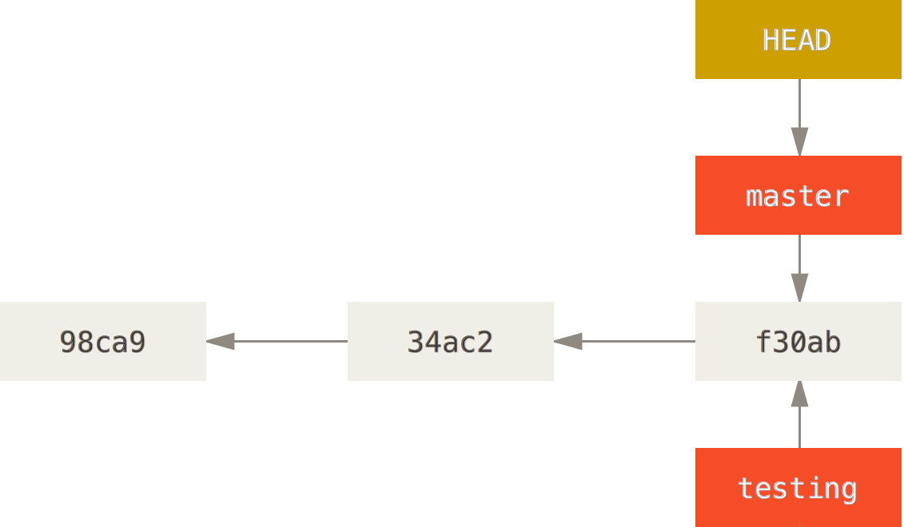
Create new branches (2)
Via GIT command line
HEAD is a pointer to the local branch you’re currently on

Slide 34
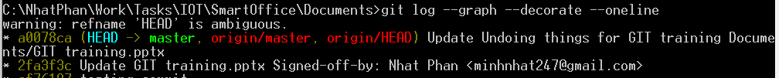
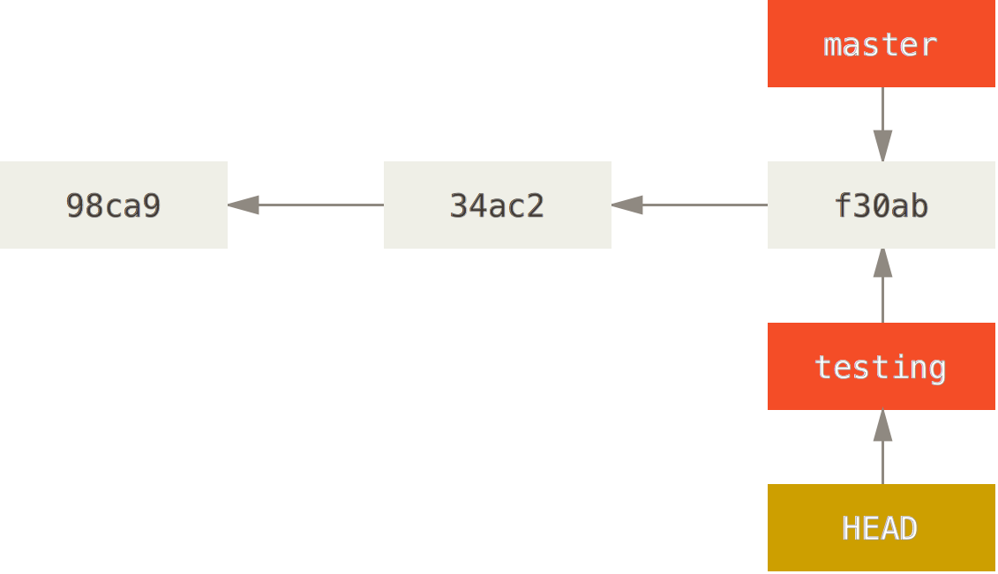
Display/switching branches
Via GIT command line
$ git log --oneline --decorate
$ git checkout testing → This moves HEAD to point to the testing branch.

Slide 35
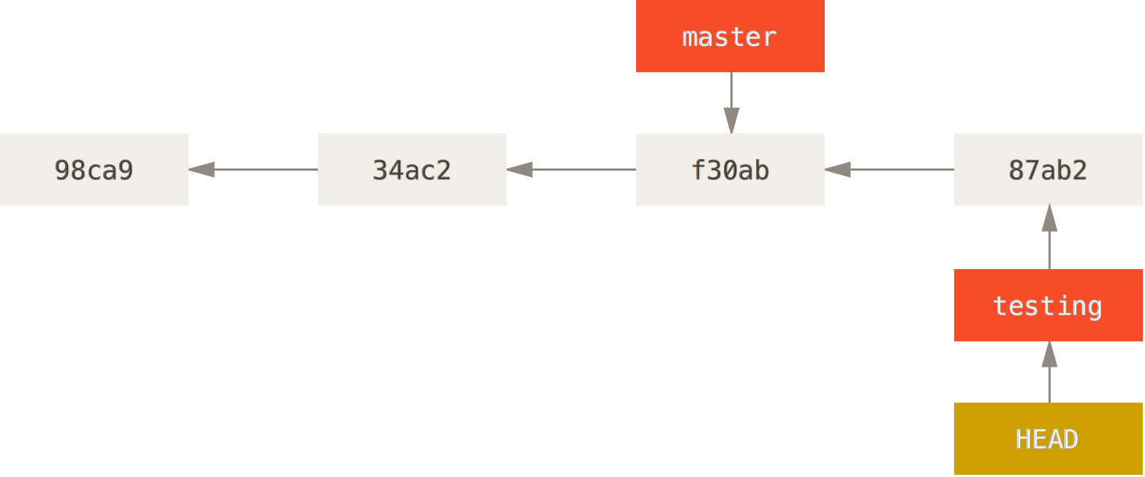
Move forward branch
Via GIT command line
$ vim test.rb
$ git commit -a -m 'made a change'
$ git checkout testing → This moves HEAD to point to the testing branch.

Slide 36
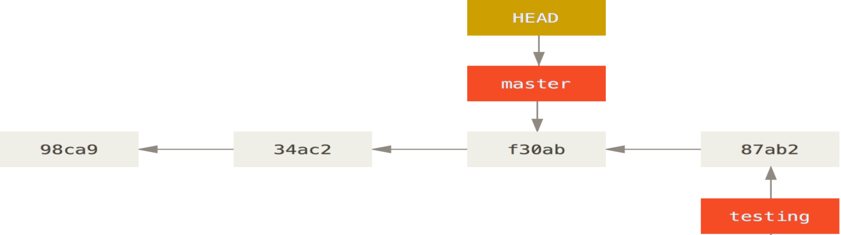
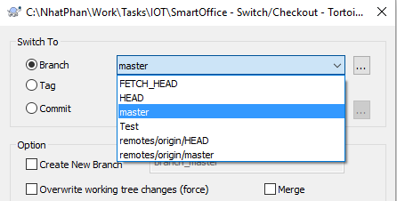
Switch/Checkout
Via GIT command line
$ git checkout master
Via TortoiseGIT:
Notes:
What happen if there is modified file when switching?

Slide 37
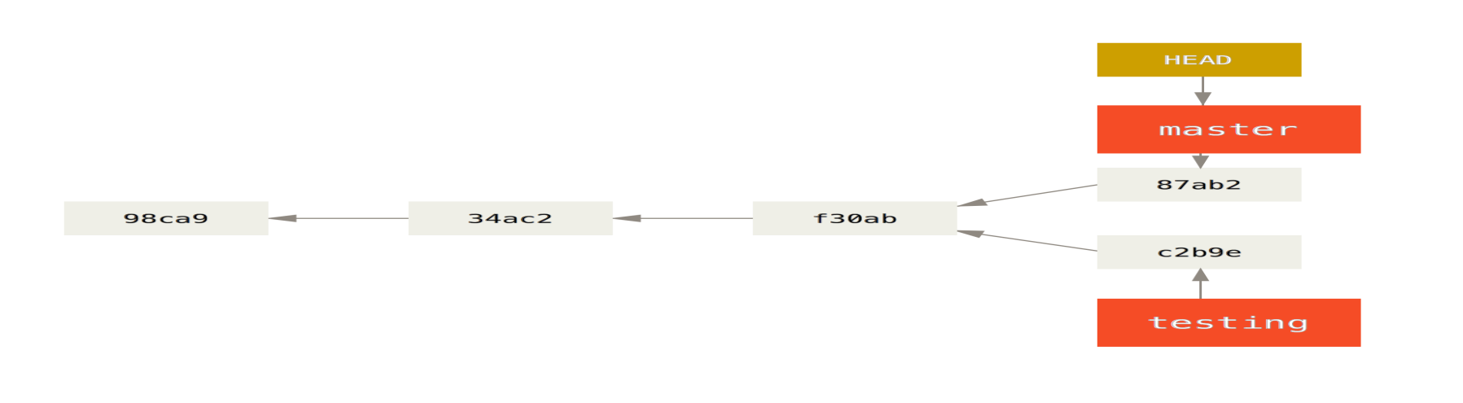
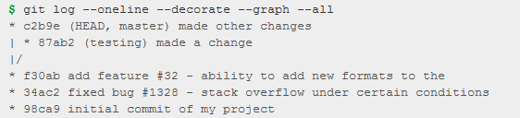
Divergent history
Via GIT command line
$ vim test.rb
$ git commit -a -m 'made other changes‘
$ git log --oneline --decorate --graph --all

Slide 38
Basic branching
Let’s go through a simple example of branching and merging with a workflow that you might use in the real world. You’ll follow these steps:
Do work on a web site.
Create a branch for a new story you’re working on.
Do some work in that branch.
At this stage, you’ll receive a call that another issue is critical and you need a hotfix. You’ll do the following:
Switch to your production branch.
Create a branch to add the hotfix.
After it’s tested, merge the hotfix branch, and push to production.
Switch back to your original story and continue working.

Slide 39
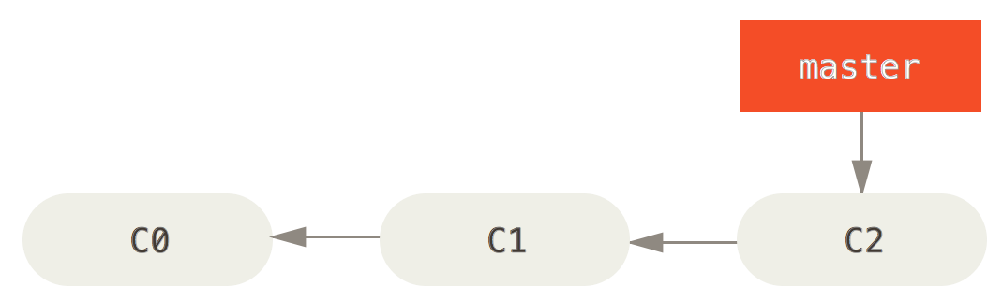
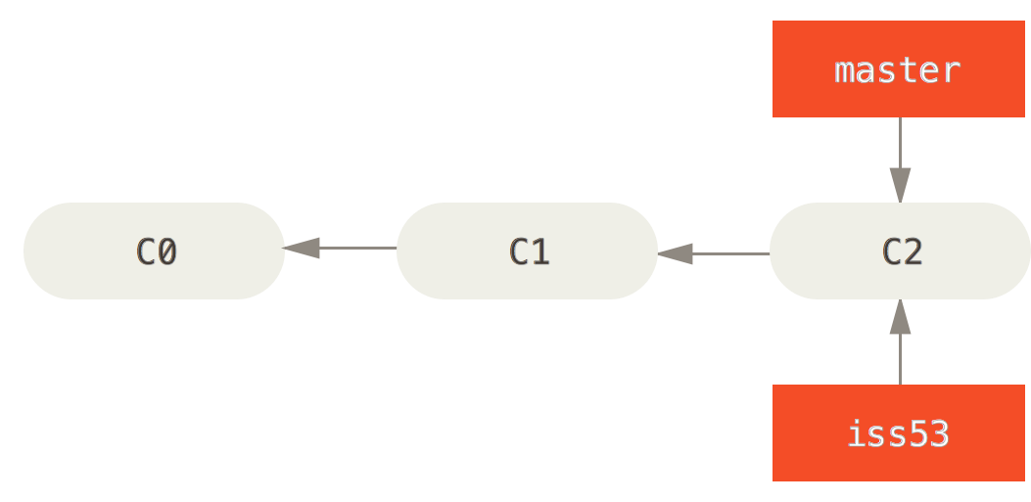
Basic branching
E.g. 3 commits in master
Start working on iss#53:
$ git checkout -b iss53
Switched to a new branch "iss53"
This is shorthand for:
$ git branch iss53
$ git checkout iss53

Slide 40
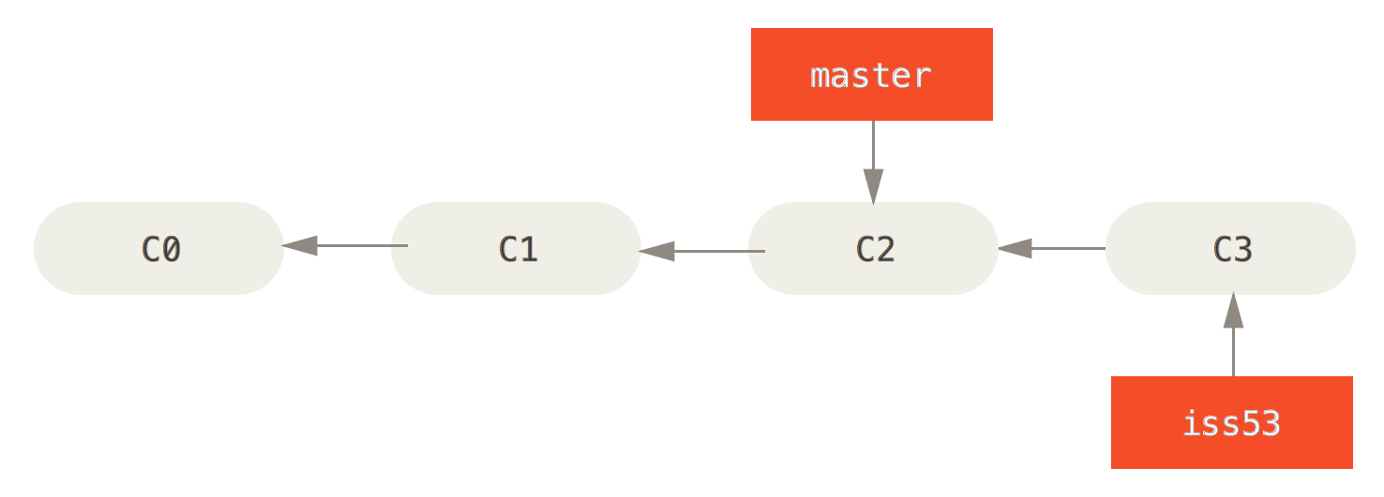

Basic branching
You work on your web site and do some commits
$ vim index.html
$ git commit -a -m 'added a new footer [issue 53]‘
Need hotfix immediately:
$ git checkout master
$ git checkout -b hotfix
$ vim index.html
$ git commit -a -m 'fixed the broken email address’

Slide 41


Basic branching and merging
Merge hotfix into master
$ git checkout master
$ git merge hotfix →fast forward
Delete hotfix
$ git branch -d hotfix
Switch back to issue#53 to work
$ git checkout iss53
$ vim index.html
$ git commit -a -m 'finished the new footer [issue 53]'

Slide 42

Basic merging
Merge iss#53 into master
$ git checkout master
$ git merge iss53
Merge made by the 'recursive' strategy. index.html | 1 + 1 file changed, 1 insertion(+)
Master is not parent of iss#53, Git does a simple three-way merge
Using two snapshots pointed to by the branch tips and the common ancestor of the two

Slide 43

Basic merging
Instead of just moving the branch pointer forward, Git creates a new snapshot that results from this three-way merge and automatically creates a new commit that points to it. This is referred to as a merge commit, and is special in that it has more than one parent.

Slide 44


Basic Merge Conflicts (1)
Change the same part in the same file in 2 branches.
E.g your fix for issue #53 modified the same part of a file as the hotfix
GIT won’t create merge commit. It paused the process for user to resolve conflicts. Need to run “git status” to check

Slide 45

Basic Merge Conflicts (2)
For merge-able file (.txt, .py, java,…)
Git adds standard conflict-resolution markers to the files that have conflicts
HEAD: your master branch (checked out branch before merging)(everything above the =======).Version in your “iss53” branch looks like everything in the bottom part
Should replace contents between “<<<<<<<, =======, and >>>>>>>” by the final solution
Run “$git add” to mark it as resolved

Slide 46


Basic Merge Conflicts (3)
If we need graphic tool to merge
Command line: git mergetool →Editor could be vi tool
TotoiseGit: Edit conflicts then saving file then resolving

Slide 47

Basic Merge Conflicts (4)
Check resolved files: git status
Commit merged files: git commit

Slide 48



Advanced Merge Conflicts (1)
List out conflicted files: git ls-files -u
Extract a copy of each of these versions : git show
Cleanup after resolving files: git clean -f

Slide 49

Advanced Merge Conflicts (2)
Merge binary files. E.g. .pptx, .bin, .jar, …
Option 1: create ours, theirs, common then editing manually as normal files.
Option 2: Decide to use ours, theirs or common file.
git checkout --ours <file>
git checkout --theirs <file>
Abort merging: git merge --abort
Notes:
Note: if binary isnot committed before merging, you won’t be allow to merge.

Slide 50


Advanced Merge Conflicts (3)
Undoing Merges. E.g.
Solution 1:
Fix the references via command git reset --hard HEAD~
Notes:
Note: if binary isnot committed before merging, you won’t be allow to merge.

Slide 51

Advanced Merge Conflicts (4)
Undoing Merges.
Solution 1: Fix the references via command git reset --hard HEAD~
Disadvantages:
It’s rewriting history, which can be problematic with a shared repository.
It won’t work if there are new commit after merging
Solution 2: Reverse the commit
git revert -m 1 HEAD
Notes:
The -m 1 flag indicates which parent is the “mainline” and should be kept. When you invoke a merge into HEAD (git merge topic), the new commit has two parents: the first one is HEAD (C6), and the second is the tip of the branch being merged in (C4). In this case, we want to undo all the changes introduced by merging in parent #2 (C4), while keeping all the content from parent #1 (C6).

Slide 52


Advanced Merge Conflicts (4)
Undoing Merges.
Solution 2: Reverse the commit
Unmerged commits ^M are still in HEAD's history
Merge again will inform nothing to merge
if you add work to topic and merge again, Git will only bring in the changes since the reverted merge.
To overcome this issue: un-revert the original merge then merge again
git revert ^M
git merge topic
Notes:
The -m 1 flag indicates which parent is the “mainline” and should be kept. When you invoke a merge into HEAD (git merge topic), the new commit has two parents: the first one is HEAD (C6), and the second is the tip of the branch being merged in (C4). In this case, we want to undo all the changes introduced by merging in parent #2 (C4), while keeping all the content from parent #1 (C6).

Slide 53

Advanced Merge Conflicts (5)
Undoing Merges.
Solution 2: Reverse the commit
In this example, M and ^M cancel out. ^^M effectively merges in the changes from C3 and C4, and C8 merges in the changes from C7, so now topic is fully merged.

Slide 54
Branch management
List out branches: git branch
Show the last commit on each branch: git branch –v
Show which branches are already merged into the branch you’re on: git branch --merged
Show all the branches that contain work you haven’t yet merged in: git branch --no-merged

Slide 55


Working with remotes (1)
“origin” is the default name of a remote
To show remote branches: git remote show “remotename”
Remote branch could have the same name with local branch

Slide 56

Working with remotes (2)
If you do some work on your local master branch
If someone else update remote, info in your machines won’t change

Slide 57

Working with remotes (3)
Synchronize your work with remote: git fetch origin

Slide 58

Working with remotes (4)
Pushing: “git push origin serverfix” or “git push origin serverfix:serverfix”
If others want to get new updates:
git fetch origin → update from server
git checkout -b serverfix origin/serverfix →copy into new local branch
git merge origin/serverfix → merge into current branch
git pull → fetching then merging
Delete remote branches: git push origin --delete serverfix

Slide 59
Working with remotes (5)
Multiple remotes: TBD

Slide 60


Rebase (1)
3 ways merging
Rebase: take the patch of C4 and reapply on C3
git checkout experiment
git rebase master
Notes:
https://git-scm.com/book/en/v2/Git-Branching-Rebasing
It works by going to the common ancestor of the two branches (the one you’re on and the one you’re rebasing onto), getting the diff introduced by each commit of the branch you’re on, saving those diffs to temporary files, resetting the current branch to the same commit as the branch you are rebasing onto, and finally applying each change in turn.

Slide 61
Rebase (2)
How rebase works?
Going to common ancestor of 2 branches
Generate diff by each commit of your current branch
Saving those diffs to temporary files
Reset the current branch to the same commit as the branch you are rebasing onto
Applying each changes in turn

Slide 62

Rebase (3)
Next steps after rebasing:
Go back to the master branch
Do a fast-forward merge.
$ git checkout master
$ git merge experiment
The snapshot pointed to by C4' is exactly the same as the one that was pointed to by C5 in the merge example

Slide 63
Rebase (4)
Benefit of rebase: cleaner history
Disadvantage: Do not rebase commits that exist outside your repository.
When you rebase stuff, you’re abandoning existing commits and creating new ones that are similar but different. If you push commits somewhere and others pull them down and base work on them, and then you rewrite those commits with git rebase and push them up again, your collaborators will have to re-merge their work and things will get messy when you try to pull their work back into yours

Slide 64


Rebase (5)
Disadvantage:
Someone else does more work that includes a merge, and pushes that work to the central server.

Slide 65


Rebase (6)
The person who pushed the merged work decides to go back and rebase their work instead. “git push --force“ to overwrite history
If you do a git pull you will merge C4 again. History is duplicated.

Slide 66

Rebase (7)
If you push this history back up to the server, you’ll reintroduce all those rebased commits to the central server, which can further confuse people
For handling this case we should use command: git rebase teamone/master. Git will recognize only C2 and C3 are changes to rebase. This only works if C4 and C4' that your partner made are almost exactly the same patch.
Notes:
It turns out that in addition to the commit SHA-1 checksum, Git also calculates a checksum that is based just on the patch introduced with the commit. This is called a “patch-id”.
If you pull down work that was rewritten and rebase it on top of the new commits from your partner, Git can often successfully figure out what is uniquely yours and apply them back on top of the new branch.
For instance, in the previous scenario, if instead of doing a merge when we’re at Figure 3-38 we run git rebase teamone/master, Git will:
Determine what work is unique to our branch (C2, C3, C4, C6, C7)
Determine which are not merge commits (C2, C3, C4)
Determine which have not been rewritten into the target branch (just C2 and C3, since C4 is the same patch as C4')
Apply those commits to the top of teamone/master
This only works if C4 and C4' that your partner made are almost exactly the same patch. Otherwise the rebase won’t be able to tell that it’s a duplicate and will add another C4-like patch (which will probably fail to apply cleanly, since the changes would already be at least somewhat there).

Slide 67
Rebase vs Merge
Now that you know how both of these things work, it’s up to you to decide which one is best for your particular situation
In general the way to get the best of both worlds is to:
Rebase local changes you’ve made but haven’t shared yet before you push them in order to clean up your story
But never rebase anything you’ve pushed somewhere.
Notes:
Rebase local changes to clean up history
Merge when take actions on remote server

Slide 68

Workflows

Slide 69

Workflows

Slide 70

Merge roles

Slide 71

Merge roles

Slide 72
Code review
Crucible (Refer to Crucible training)
Gerrit (Refer to Gerrit training)

Slide 73
Exercise 1
Create a git hub project
Clone/modify/add/commit
Delete file/commit
Create branches
Print out commit graph/branches
Revert file
Switch/Checkout branches

Slide 74
Exercise 2
Undoing things: specific file, reset to a commit
Merge fast forward
Merge with conflicts
Rebase
Practicing on workflows: master, hotfix, dev, feature branches

Slide 75
References
GIT book: https://git-scm.com/book
GIT training - Ilkka Turunen jamk.fi
https://www.atlassian.com/git/tutorials/undoing-changes

Slide 76

Backup
^ vs ~
^^^#
~#
Notes:
http://schacon.github.io/git/git-rev-parse#_specifying_revisions
<rev>^, e.g. HEAD^, v1.5.1^0 A suffix ^ to a revision parameter means the first parent of that commit object. ^<n> means the <n>th parent (i.e. <rev>^ is equivalent to <rev>^1). As a special rule, <rev>^0 means the commit itself and is used when <rev> is the object name of a tag object that refers to a commit object.
<rev>~<n>, e.g. master~3 A suffix ~<n> to a revision parameter means the commit object that is the <n>th generation grand-parent of the named commit object, following only the first parents. I.e. <rev>~3 is equivalent to <rev>^^^ which is equivalent to <rev>^1^1^1. See below for an illustration of the usage of this form.

Slide 77


